Slide 1
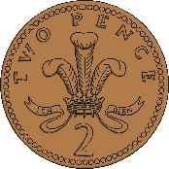
Year 2 Money
Lesson 2: Find the sum of different amounts of pound

Slide 2
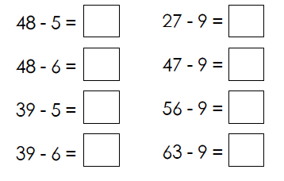
Number Fact check
Unit: Money

Slide 3
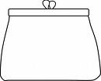
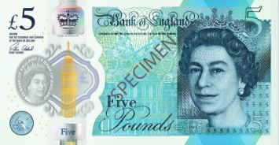
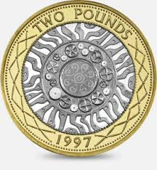
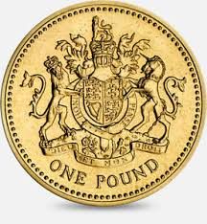
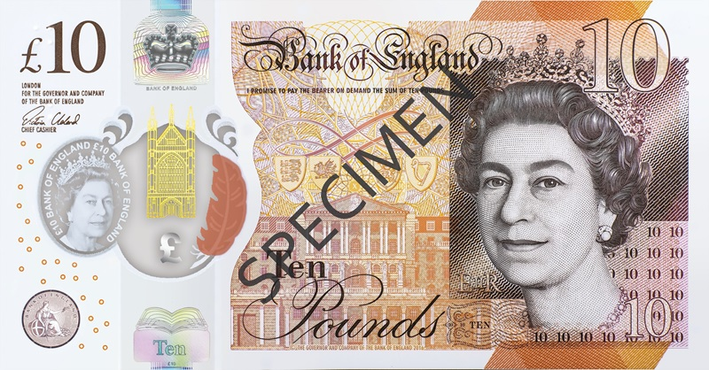
We are learning to:
Find the sum of different amounts of pounds:

Slide 4
What do we know already?
The number on the note or coin tells us how much it is worth.

Slide 5
Hook
BBC Bitesize: How to work out a value with coins
https://www.bbc.co.uk/bitesize/topics/zp8dmp3/articles/zcrq2p3

Slide 6
Teach it
Key Vocabulary:
money coin
note £1 £2
£5 £10
Add the purses together to find out how much money I have altogether.
Altogether I have….
£18
£7
£11
Stem Sentence: We can use our knowledge of addition to work out the sum of money.

Slide 7
Practise it
Key Vocabulary:
money coin
note £1 £2
£5 £10
Add the purses together to find out how much money I have altogether.
Altogether I have….
£68
£50
£15
£3
Stem Sentence: We can use our knowledge of addition to work out the sum of money.

Slide 8
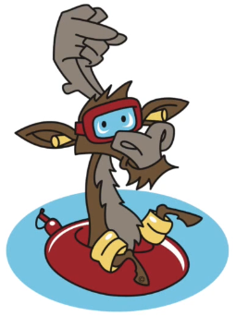
Do it
What is the total of each set?
1.
+
2.
3.
4.
5.
Stem Sentence: We can use our knowledge of addition to work out the sum of money.

Slide 9
Twist it
Coco thinks that the total of £5 and £10 is £60 .
Explain why she is incorrect?
Coco is incorrect because
Stem Sentence: We can use our knowledge of addition to work out the sum of money.

Slide 10
Solve it
Colin buys 3 items. Investigate how much he could have spent.
What is the least and most amount he could have spent?
Stem Sentence: We can use our knowledge of addition to work out the sum of money.

Slide 11
Coming together to feel successful. Confirming the learning.
money coin
note £1 £2
£5 £10
What have
we learnt?
Stem Sentence:
We can use our knowledge of addition to work out the sum of money.

