Slide 1
Year 2 Statistics
Lesson 7 - Interpret a pictogram where the symbol represents 5 or 10 items

Slide 2
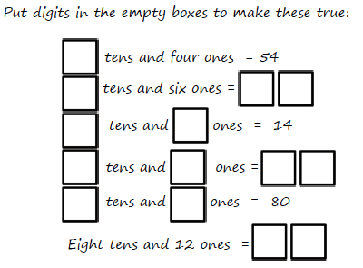
Unit: Statistics
Number Fact check

Slide 3
What do we already know?
A table can be used to display pieces of data about different things.
The fifth tally mark is always drawn across the other four like this llll.
A pictogram uses pictures to represent data.
The key tells us how many items each symbol represents.
½ a symbol represents ½ of the amount.
The key tells us how many items each symbol represents.

Slide 4
We are learning to:
Interpret a pictogram where the symbol
represents 5 or 10 items.
How many?

Slide 5
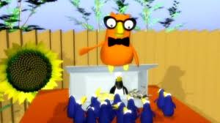
https://www.bbc.co.uk/bitesize/clips/zg4d2hv
Hook
BBC Bitesize: Understanding pictograms

Slide 6
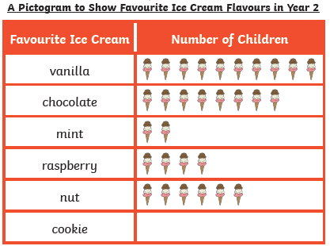
Teach it
Key Vocabulary:
data table headings
column most least
tally chart pictogram
symbol represents
What is a pictogram?
We know that a pictogram is a chart that uses pictures or symbols to show information. It is quicker and easier to interpret results in a pictogram than a tally chart.
In this pictogram each symbol (ice-cream) represents 1 child.
Stem Sentence: The key tells us how many items each symbol represents.

Slide 7
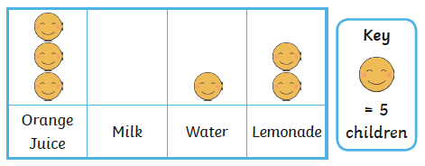
Teach it
Key Vocabulary:
We need to look at the key to see how many items each symbol represents.
data table headings
column most least
tally chart pictogram
symbol represents
In this pictogram each symbol (smiley face) represents 5 children.
Stem Sentence: The key tells us how many items each symbol represents.

Slide 8
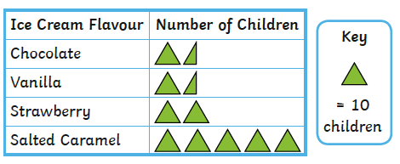
Teach it
Key Vocabulary:
We need to look at the key to see how many items each symbol represents.
data table headings
column most least
tally chart pictogram
symbol represents
In this pictogram each symbol (green triangle) represents 10 children.
Stem Sentence: The key tells us how many items each symbol represents.

Slide 9
Teach it
We can use our knowledge of the 5 times table to count symbols.
Key
= 5 cats.
=
?
How many cats are there?
There are 25 cats.
Stem Sentence: The key tells us how many items each symbol represents.

Slide 10
Teach it
Lets check!
=
=
=
=
=
There are 25 cats.
Stem Sentence: The key tells us how many items each symbol represents.

Slide 11
Teach it
We can use our knowledge of the 10 times table to count symbols.
Key
= 10 trees.
=
?
How many trees are there?
There are 40 trees.
Stem Sentence: The key tells us how many items each symbol represents.

Slide 12
Teach it
Lets check!
=
=
=
=
There are 40 trees.
Stem Sentence: The key tells us how many items each symbol represents.

Slide 13
Teach it
Key Vocabulary:
data table headings
column most least
tally chart pictogram
symbol represents
We know that in this pictogram each symbol represents 10 children.
There is ½ a square.
½ of 10 is 5. This symbol represents 5 children.
Look carefully!
What do you notice?
Stem Sentence: The key tells us how many items each symbol represents.

Slide 14
Teach it
We know that ½ a symbol represents ½ of the amount.
Key
= 10 drinks.
=
?
Look carefully!
How many drinks are there?
This is only ½ a glass.
This symbol represents 5 drinks.
There are 65 drinks.
Stem Sentence: The key tells us how many items each symbol represents.

Slide 15
Teach it
Lets check!
=
=
=
There are 65 drinks.
=
=
=
=
Stem Sentence: The key tells us how many items each symbol represents.

Slide 16
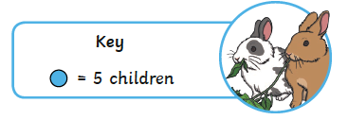
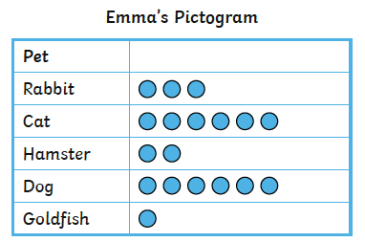
Practise it
Emma has drawn a pictogram to show how many
children in her class have pets.
30
How many children have cats?
5
How many children have a goldfish?
How many more children have rabbits than hamsters?
5
How many fewer children have dogs than
cats?
0. There are the same amount of cats and dogs.

Slide 17
Practise it
Scott has drawn a pictogram to show how many
children in his class have pets.
30
How many children have cats?
5
How many children have a goldfish?
How many more children have rabbits than hamsters?
5
How many fewer children have dogs than
cats?
0. There are the same amount of cats and dogs.

Slide 18
Do it
= 2 people
The pictograms show birds seen in one day.
A
B
= 5 birds.
= 10 birds.
Robins
Pigeon
Finch
Thrush
Robins
Pigeon
Finch
Thrush
How many Robins were seen?
How many Pigeons were seen?
How many more Pigeons than Thrushes were seen?
How many birds were seen altogether?
Which bird was seen the least?
Stem Sentence: The key tells us how many items each symbol represents.

Slide 19
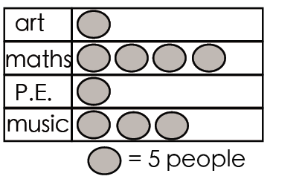
Twist it
and row.
Colin thinks that 4 people like maths.
Explain why he is incorrect?
Colin is incorrect because
Stem Sentence: The key tells us how many items each symbol represents.

Slide 20
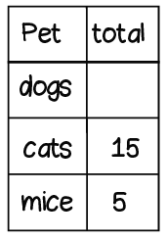
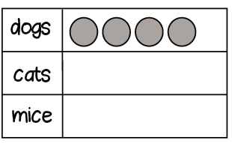
Solve it
and row.
The table and pictogram show the same information.
Investigate different ways of completing them.
Stem Sentence: The key tells us how many items each symbol represents.

Slide 21
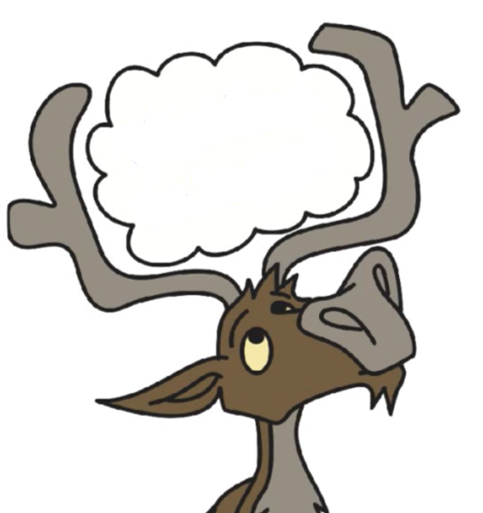
and row.
Coming together to feel successful. Confirming the learning.
data table headings
column most least
tally chart pictogram
symbol represents
What have
we learnt?
Stem Sentence: The key tells us how many items each symbol represents.

