Slide 1
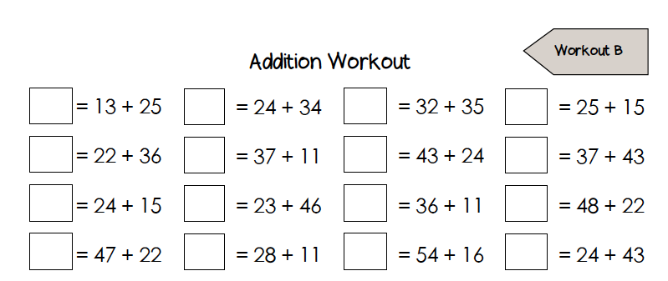
Number Fact check
Unit: Time

Slide 2
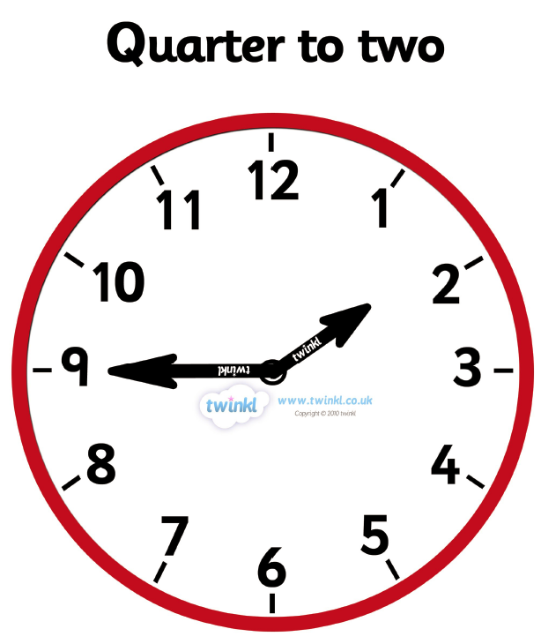
We are learning to:
Tell the time using quarter to the hour on an analogue clock

Slide 3
Hook
Click on the link below to watch this video.
Telling the Time - Time for Kids: Quarter Past, Half Past, Quarter To
https://www.youtube.com/watch?v=Pht7dTlM0VA

Slide 4
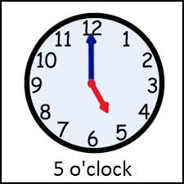
What have we already learnt?
Time to the hour
Key Vocabulary:
time clock
hour hand
minute hand
quarter past
quarter to
The long hand is the minute hand. When it points to 12, it shows an o’clock time.
The short hand is the hour hand. This tells us what hour it is.
Stem Sentence: When the minute hand is on the number 9, the time is always quarter to the hour.

Slide 5
Key Vocabulary:
What have we already learnt?
Quarter past the hour
time clock
hour hand
minute hand
quarter past
The long hand is the minute hand. When it points to 3, it shows a quarter past time.
The short hand is the hour hand. This tells us what hour it is.
Stem Sentence: When the minute hand is on the number 9, the time is always quarter to the hour.

Slide 6
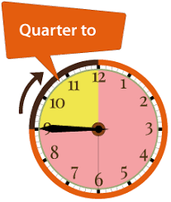
Teach it
Key Vocabulary:
time clock
hour hand
minute hand
quarter past
quarter to
Quarter to the hour
The long hand is the minute hand. When it points to 9, it shows a quarter to time.
The short hand is the hour hand. This tells us what hour it is.
Stem Sentence: When the minute hand is on the number 9, the time is always quarter to the hour.

Slide 7
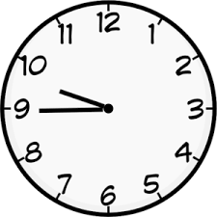
Practise it
Look at the clocks below. What time do they show?
Quarter to 2
Quarter to 10
Quarter to 9
Stem Sentence: When the minute hand is on the number 9, the time is always quarter to the hour.

Slide 8
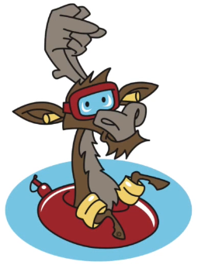
Do it
Now it’s your go!
Look at the clocks. Write the time each one shows in your book.
Stem Sentence: When the minute hand is on the number 9, the time is always quarter to the hour.

Slide 9
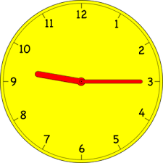
Twist it
Coco thinks that the time is quarter to 3
Explain why she is incorrect?
Coco is incorrect because
Stem Sentence: When the minute hand is on the number 9, the time is always quarter to the hour.

Slide 10
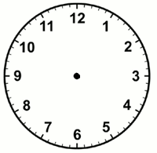
Solve it
Always/Sometimes/Never True
If one of the hands is pointing to the 9 then it is quarter to something.
Stem Sentence: When the minute hand is on the number 9, the time is always quarter to the hour.

Slide 11
Coming together to feel successful. Confirming the learning.
time clock
hour hand
minute hand
quarter past
quarter to
What have
we learnt?
Stem Sentence: When the minute hand is on the number 9, the time is always quarter to the hour.

