Slide 1
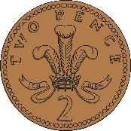
Year 2 Money
Lesson 3: Combine 1p, 2p and 5p coins to make different totals

Slide 2
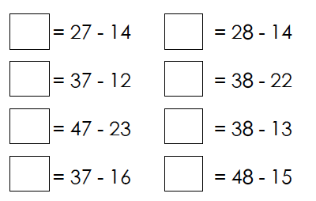
Number Fact check
Unit: Money

Slide 3
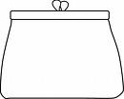
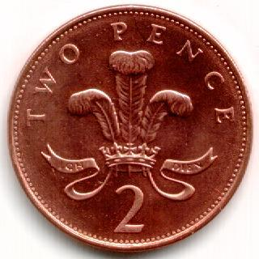
We are learning to:
Combine 1p, 2p and 5p coins to make different totals:
2 pence
1 pence
5 pence

Slide 4
What do we know already?
The number on the note or coin tells us how much it is worth
We can use our knowledge of addition to work out the sum of money

Slide 5
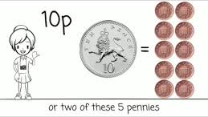
Hook
Money Song for Children UK
https://www.youtube.com/watch?v=dFzAU3u06Ps

Slide 6
Teach it
Key Vocabulary:
money coin
note £1 £2
£5 £10
1p 2p 5p
Add the coins together to find out how much money is in each purse.
9p
62p
Stem Sentence: We can use our knowledge of multiplication to work out the sum of money.

Slide 7
Practise it
Key Vocabulary:
money coin
note £1 £2
£5 £10
1p 2p 5p
Add the coins together to find out how much money is in each purse.
27p
33p
12p
Stem Sentence: We can use our knowledge of multiplication to work out the sum of money.

Slide 8
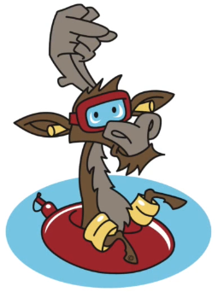
Do it
How much money is in each purse?
1.
2.
3.
4.
5.
Stem Sentence: We can use our knowledge of multiplication to work out the sum of money.

Slide 9
Twist it
Coco thinks that she has 3p in her purse.
Explain why she is incorrect?
Coco is incorrect because
Stem Sentence: We can use our knowledge of multiplication to work out the sum of money.

Slide 10
Solve it
Colin has some 1p, 2p and 5p coins. He chooses three coins.
|Investigate how much money he might have.
Stem Sentence: We can use our knowledge of multiplication to work out the sum of money.

Slide 11
Coming together to feel successful. Confirming the learning.
money coin
note £1 £2
£5 £10
1p 2p 5p
What have
we learnt?
Stem Sentence:
We can use our knowledge of multiplication to work out the sum of money.

