Slide 1
Number Fact check
Unit: Time
57cm 75cm
32cm 23cm
100cm 1m
91cm 19cm
33cm 33m
Complete these sentences using <, > or =

Slide 2
KLP: Draw the hands on a clock to show 5 minute intervals to the hour on an analogue clock
Hook
How to Tell Time! 60 Minutes is an Hour! (count by 5's)
https://www.youtube.com/watch?v=zVpqZSzoe5I

Slide 3
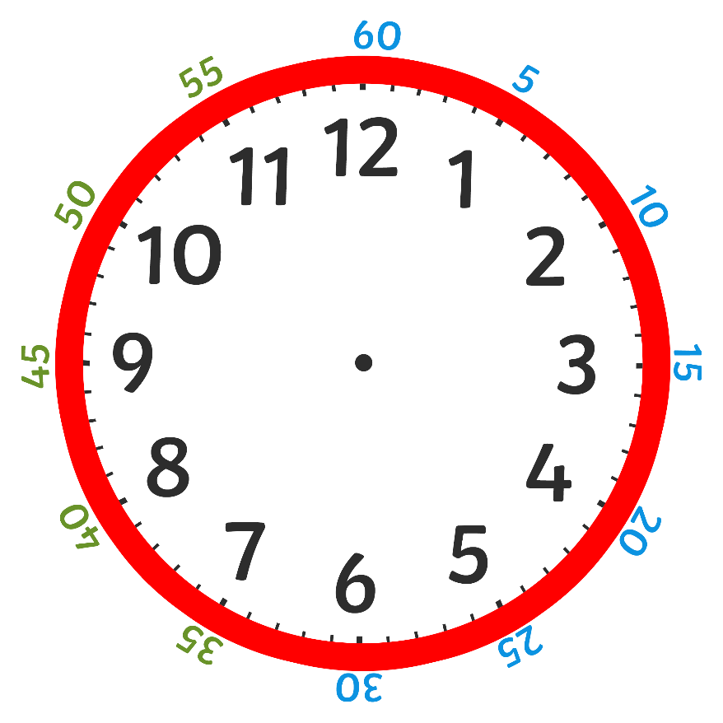
Teach it
Key Learning Point: Draw the hands on a clock to show 5 minute intervals to the hour on an analogue clock
Key Vocabulary:
time clock
hour hand
minute hand
quarter past
quarter to
60 minutes hour
past to
After the minute hand passes half past, the time stops being ‘minutes past’ and becomes ‘minutes to’.
This is slightly trickier because the minutes on the outside of the clock are still counting past the hour.
Stem Sentence: After the minute hand passes half past, the time stops being ‘minutes past’ and becomes ‘minutes to’.

Slide 4
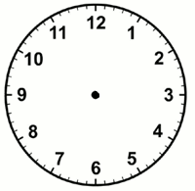
Teach it
Key Learning Point: Draw the hands on a clock to show 5 minute intervals to the hour on an analogue clock
Key Vocabulary:
time clock
hour hand
minute hand
quarter past
quarter to
60 minutes hour
past to
Let’s draw ten to 5 on the clock!
The minute hand points to 10 and the hour hand points to just before the 5.
Stem Sentence: After the minute hand passes half past, the time stops being ‘minutes past’ and becomes ‘minutes to’.

Slide 5
Practise it
Key Learning Point: Draw the hands on a clock to show 5 minute intervals to the hour on an analogue clock
Let’s draw:
Five to 11
Twenty to 6
Twenty five to 4
Stem Sentence: After the minute hand passes half past, the time stops being ‘minutes past’ and becomes ‘minutes to’.

Slide 6
Do it
Key Learning Point: Draw the hands on a clock to show 5 minute intervals to the hour on an analogue clock
Draw hands on the clock to show:
Five to 4
Twenty to 11
Ten to 3
Twenty five to 10
Twenty to 2
Stem Sentence: After the minute hand passes half past, the time stops being ‘minutes past’ and becomes ‘minutes to’.

Slide 7
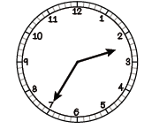
Twist it
Key Learning Point: Draw the hands on a clock to show 5 minute intervals to the hour on an analogue clock
Coco thinks she has drawn hands to show twenty five to 2.
Explain why she is incorrect?
Coco is incorrect because
Stem Sentence: After the minute hand passes half past, the time stops being ‘minutes past’ and becomes ‘minutes to’.

Slide 8
Solve it
Key Learning Point: Draw the hands on a clock to show 5 minute intervals to the hour on an analogue clock
Always/Sometimes/Never True
If one hand is pointing to the 7 then it is ‘twenty five to something.’
Stem Sentence: After the minute hand passes half past, the time stops being ‘minutes past’ and becomes ‘minutes to’.

Slide 9
Coming together to feel successful. Confirming the learning.
time clock
hour hand
minute hand
quarter past
quarter to
60 minutes hour
past to
What have
we learnt?
Stem Sentence: After the minute hand passes half past, the time stops being ‘minutes past’ and becomes ‘minutes to’.

