Slide 1
Number Fact check
Unit: Time
16g 61g
32kg 23g
10g 10kg
91g 91g
13g 103g
Complete these sentences using <, > or =

Slide 2
KLP: Order or sequence intervals of time, including the fact that there are 24 hours in one day
Hook
What time is it?
https://www.youtube.com/watch?v=1eGkW3JnthI

Slide 3
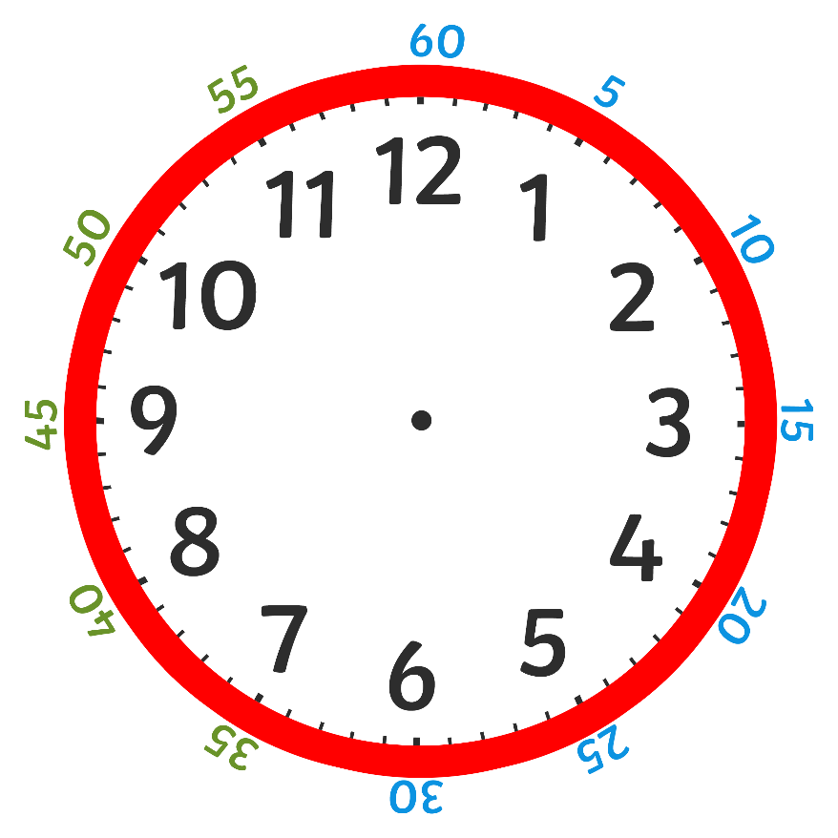
Teach it
Key Learning Point: Order or sequence intervals of time, including the fact that there are 24 hours in one day
Key Vocabulary:
time clock
hour hand
minute hand
quarter past
quarter to
60 minutes hour
past to
24 hours in a day
The are 24 hours in one day. The hour hand travels around the clock 24 times.
Stem Sentence: There are 24 hours in one day.

Slide 4
Teach it
Key Learning Point: Order or sequence intervals of time, including the fact that there are 24 hours in one day
Key Vocabulary:
time clock
hour hand
minute hand
quarter past
quarter to
60 minutes hour
past to
24 hours in a day
Let’s put these times in order from shortest to longest.
30 minutes
5 minutes
45 minutes
Stem Sentence: There are 24 hours in one day.

Slide 5
Practise it
Key Learning Point: Order or sequence intervals of time, including the fact that there are 24 hours in one day
Let’s put these times in order from shortest to longest.
60 minutes 35 minutes 15 minutes
7 hours 20 hours 13 hours
1 hour 1 day 16 hours
Stem Sentence: There are 24 hours in one day.

Slide 6
Do it
Key Learning Point: Order or sequence intervals of time, including the fact that there are 24 hours in one day
Put these sets in order from shortest to longest.
1. 40 minutes, 10 minutes, 55 minutes
2. 45 minutes, 50 minutes, 1 hour
3. 75 minutes, 1 hour, 25 minutes
4. 1 day, 12 hours, 25 hours
5. 30 hours, 30 minutes, 1 day
Stem Sentence: There are 24 hours in one day.

Slide 7
Twist it
Key Learning Point: Order or sequence intervals of time, including the fact that there are 24 hours in one day
Coco thinks that 26 hours is shorter than 1 day.
Explain why she is incorrect?
Coco is incorrect because
Stem Sentence: There are 24 hours in one day.

Slide 8
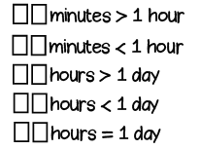
Solve it
Key Learning Point: Order or sequence intervals of time, including the fact that there are 24 hours in one day
Find the missing digits.
Solve them using the digits 2, 4, 6 and 0 at least once.
Stem Sentence: There are 24 hours in one day.

Slide 9
Coming together to feel successful. Confirming the learning.
time clock
hour hand
minute hand
quarter past
quarter to
60 minutes hour
past to
24 hours in a day
What have
we learnt?
Stem Sentence: After the minute hand passes half past, the time stops being ‘minutes past’ and

