Slide 1
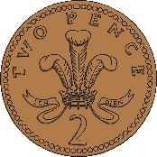
Year 2 Money
Lesson 5: Find the sum of different amounts of pence

Slide 2
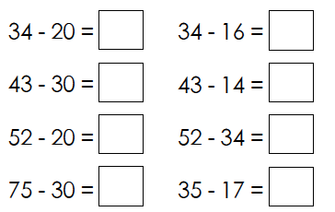
Number Fact check
Unit: Money

Slide 3
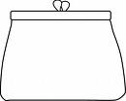
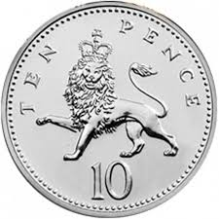
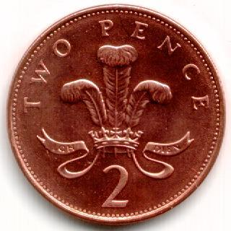
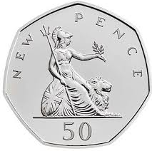
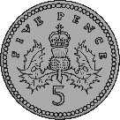
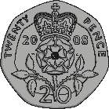
We are learning to:
Find the sum of different amounts of pence:
2p
50p
10p
5p
20p
1p

Slide 4
What do we know already?
The number on the note or coin tells us how much it is worth
We can use our knowledge of addition to work out the sum of money
We can use our knowledge of multiplication to work out the sum of money
We can use our knowledge of the 10 times table to work out the sum of money

Slide 5
Hook
UK Coins Explained for Kids - Maths Money Learning Video
https://www.youtube.com/watch?v=vs8F_g3MGtM

Slide 6
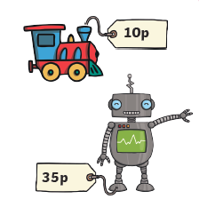
Teach it
Key Vocabulary:
money coin sum
note £1 £2 £5
£10 1p 2p 5p
10p 20p 50p
Coco has been to the toy shop. She bought a train and a robot. How much did she spend?
10p + 35p =
When adding different amounts, it is easier to start with the largest amount first!
35p + 10p =
T
O
45p
3
1
5
0
4
5
Stem Sentence: We can use our knowledge of addition to work out the sum of money.

Slide 7
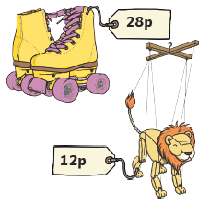
Teach it
Key Vocabulary:
money coin sum
note £1 £2 £5
£10 1p 2p 5p
10p 20p 50p
Coco has been to the toy shop. She bought a puppet and some roller skates. How much did she spend?
28p + 12p =
40p
T
O
Remember to exchange groups of 10!
2
1
1
8
2
10
4
0
Stem Sentence: We can use our knowledge of addition to work out the sum of money.

Slide 8
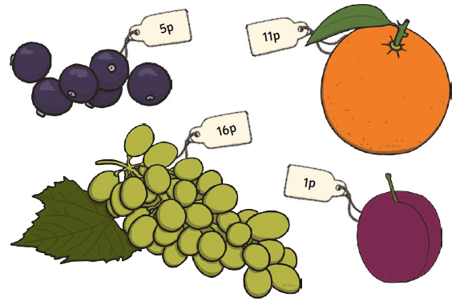
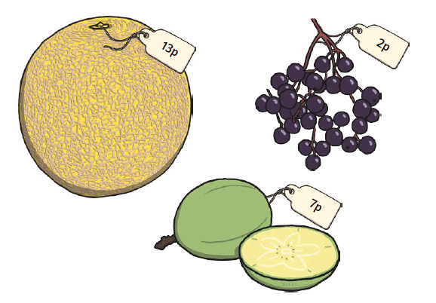
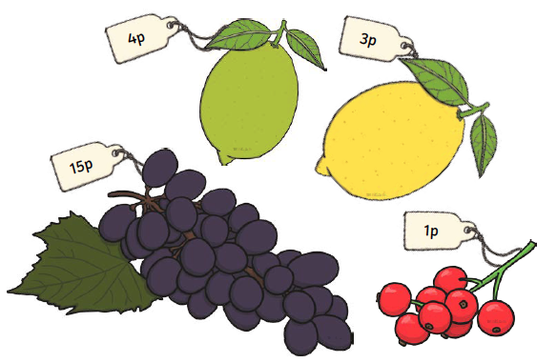
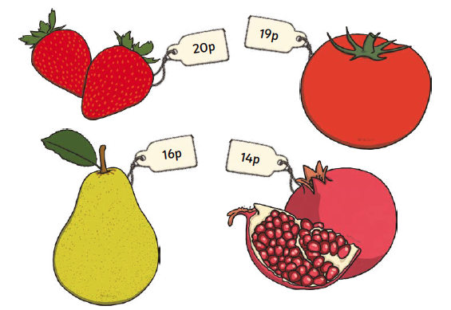
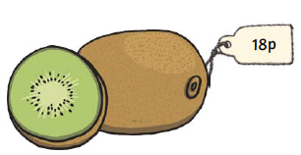
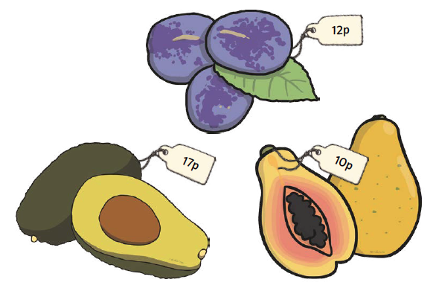
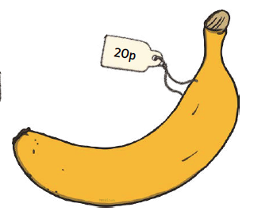
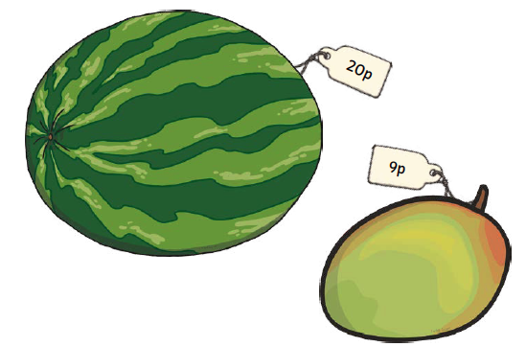
Practise it
Choose two pieces of fruit. How much do they cost?
Stem Sentence: We can use our knowledge of addition to work out the sum of money.

Slide 9
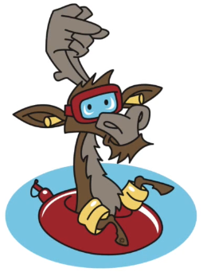
Do it
Calculate:
10p + 5p =
20p + 25p =
27p + 23p =
28p + 24p =
= 16p + 8p + 20p
Stem Sentence: We can use our knowledge of addition to work out the sum of money.

Slide 10
Twist it
Coco thinks that:
10p + 5p = 15
Explain why she is incorrect?
Coco is incorrect because
Stem Sentence: We can use our knowledge of addition to work out the sum of money.

Slide 11
Solve it
Coco buys three items. Investigate how much she could have spent.
What is the least and most she could have spent?
Stem Sentence: We can use our knowledge of addition to work out the sum of money.

Slide 12
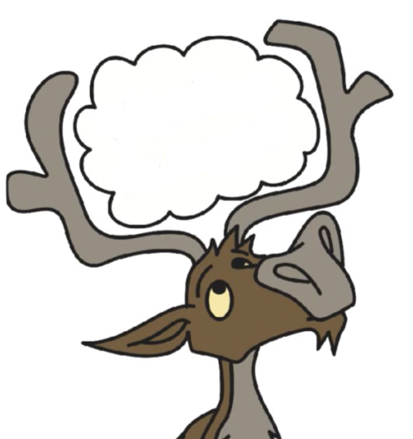
Coming together to feel successful. Confirming the learning.
money coin sum
note £1 £2 £5
£10 1p 2p 5p
10p 20p 50p
What have
we learnt?
Stem Sentence:
We can use our knowledge of addition to work out the sum of money.

