Slide 1
Year 2 Statistics
Lesson 5 - Interpret a pictogram where the symbol represents 2 items

Slide 2
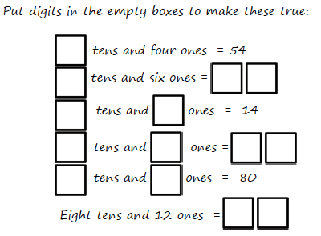
Unit: Statistics
Number Fact check

Slide 3
What do we already know?
A table can be used to display pieces of data about different things
The fifth tally mark is always drawn across the other four like this llll.
A pictogram uses pictures to represent data.

Slide 4
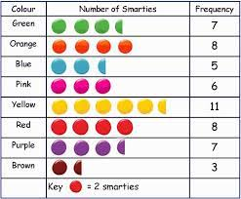
We are learning to:
Interpret a pictogram where the symbol
represents 2 items.
How many?

Slide 5
https://www.bbc.co.uk/bitesize/clips/zg4d2hv
Hook
BBC Bitesize: Understanding pictograms

Slide 6
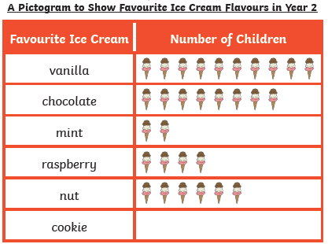
Teach it
Key Vocabulary:
data table headings
column most least
tally chart pictogram
symbol represents
What is a pictogram?
We know that a pictogram is a chart that uses pictures or symbols to show information. It is quicker and easier to interpret results in a pictogram than a tally chart.
In this pictogram each symbol (ice-cream) represents 1 child.
Stem Sentence: The key tells us how many items each symbol represents.

Slide 7
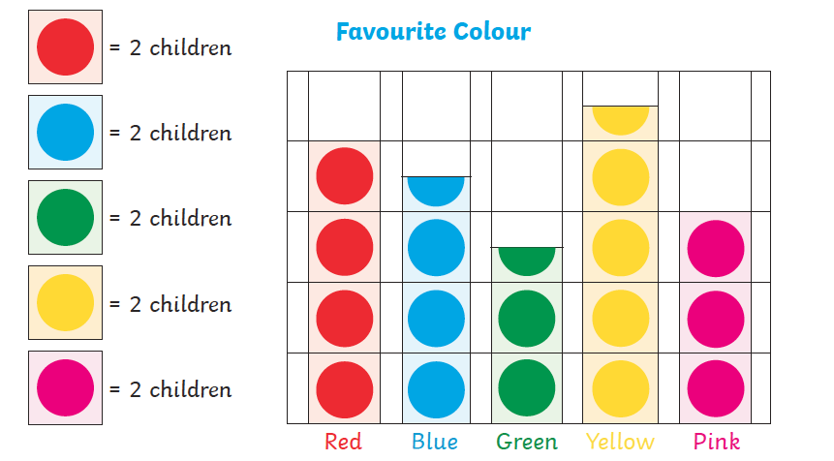
Teach it
Key Vocabulary:
We need to look at the key to see how many items each symbol represents.
data table headings
column most least
tally chart pictogram
symbol represents
In this pictogram each symbol (coloured dot) represents 2 children.
Stem Sentence: The key tells us how many items each symbol represents.

Slide 8
Teach it
We can use or knowledge of the 2 times table to count symbols.
Key
= 2 cats.
=
?
How many cats are there?
There are 10 cats.
Stem Sentence: The key tells us how many items each symbol represents.

Slide 9
Teach it
Lets check!
=
=
=
=
=
There are 10 cats.
Stem Sentence: The key tells us how many items each symbol represents.

Slide 10
Teach it
We can use or knowledge of the 2 times table to count symbols.
Key
= 2 trees.
=
?
How many trees are there?
There are 8 trees.
Stem Sentence: The key tells us how many items each symbol represents.

Slide 11
Teach it
Lets check!
=
=
=
=
There are 8 trees.
Stem Sentence: The key tells us how many items each symbol represents.

Slide 12
Teach it
Key Vocabulary:
data table headings
column most least
tally chart pictogram
symbol represents
We know that in this pictogram each symbol represents 2 children.
There is ½ a circle.
½ of 2 is 1. This symbol represents 1 child.
Look carefully!
What do you notice?
Stem Sentence: The key tells us how many items each symbol represents.

Slide 13
Teach it
We know that ½ a symbol represents ½ of the amount.
Key
= 2 drinks.
=
Look carefully!
This is only ½ a glass.
This represents 1 drink.
?
How many drinks are there?
There are 13 drinks.
Stem Sentence: The key tells us how many items each symbol represents.

Slide 14
Teach it
Lets check!
=
=
=
=
=
=
=
There are 13 drinks.
Stem Sentence: The key tells us how many items each symbol represents.

Slide 15
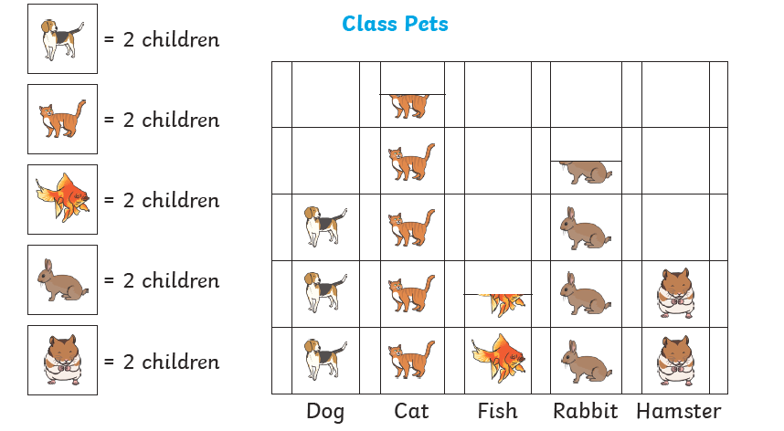
Practise it
Look at this pictogram. Tell me what you can see.
Which is the most common pet?
cat
How many pets are there in the class?
29
3
How many more rabbits than hamsters are there?
3
How many fewer dogs than cats are there?

Slide 16
Do it
and row.
People voted for names beginning with B.
A
B
How many people chose Basil?
How many chose Bob?
How many more chose Bill than Barry?
How many people voted altogether?
Which name was the most popular?
Stem Sentence: The key tells us how many items each symbol represents.

Slide 17
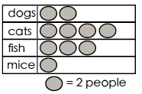
Twist it
and row.
Colin thinks that there are 3 people with fish.
Explain why he is incorrect?
Colin is incorrect because
Stem Sentence: The key tells us how many items each symbol represents.

Slide 18
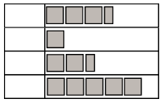
Solve it
and row.
The pictogram is about favourite animals. Label the animals.
Write three statements.
Ask three questions.
Stem Sentence: The key tells us how many items each symbol represents.

Slide 19
and row.
Coming together to feel successful. Confirming the learning.
data table headings
column most least
tally chart pictogram
symbol represents
What have
we learnt?
Stem Sentence: The key tells us how many items each symbol represents.

