Slide 1
21.04.2020
KLP: Add two single digit numbers within 10

Slide 2
What are the different ways that we can add numbers together?
9 + 1 =
We can draw it. We can draw the first number, then the second number and count how many we have altogether.

Slide 3
What are the different ways that we can add numbers together?
9 + 1 =
We can use a 10s frame by filling in the first number, then the second number and counting how many we have altogether.

Slide 4
What are the different ways that we can add numbers together?
9 + 1 =
We can use a number line to count on.

Slide 5
What are the different ways that we can add numbers together?
9 + 1 =
We can use cubes or objects.

Slide 6
Work out the answers to the following by drawing circles.
6 + 2 =
5 + 1 =
3 + 0 =

Slide 7
Work out the answers to the following by using a tens frame.
3 + 6 =
2 + 5 =
0 + 9=

Slide 8
Work out the answers to the following by using a number line.
__ = 5 + 3
__ = 2 + 6
__ = 3 + 4

Slide 9
Work out the answers to the following by counting objects.
7 + 0 +
__ 6 + 1 =
5 + 4 =

Slide 10
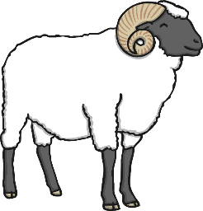
To recap
5 + 4 = 9
What is the same and what is different about these images?
Which do you find helpful?
0
1
2
3
4
5
6
7
8
9
10

Slide 11
Please write your answers in your Maths home learning book.
Do it:
4 + 3 =
4 + 5 =
6 + 3 =
__ = 3 + 6
__ = 0 + 7
Twist it:
Colin thinks that the answer to 7 + 2 is more than 6 + 3 because 7 is more than 6.
Explain why he is incorrect.
Solve it:
Always true, sometimes true or never true?
Two single digit numbers have a single digit total.
Can you prove your answer?

