Slide 1
30.04.2020
KLP: Subtract 10 from a 2 digit number up to 20

Slide 2
Subtracting 10
15 – 10 =
15 – 10 = 5
17 – 10 =
17 – 10 = 7
14 – 10 =
14 – 10 = 4
What do you notice about the answers?

Slide 3
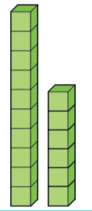
Subtracting 10
16 – 10 =
T O
T O
This means that we are left with 0 tens and 6 ones
So 16 – 10 = 6
If we are subtracting 10, we need to remove 1 lot of 10.
The number 16 is made up of 1 ten and 6 ones.

Slide 4
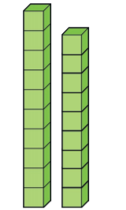
Subtracting 10
19 – 10 =
T O
T O
This means that we are left with 0 tens and 6 ones
So 19 – 10 = 9
If we are subtracting 10, we need to remove 1 lot of 10.
The number 16 is made up of 1 ten and 9 ones.

Slide 5
Look at the pattern what do you notice?
19 – 10 = 9
18 – 10 = 8
17 – 10 = 7
16 – 10 = 6
15 – 10 = 5
14 – 10 = 4
13 – 10 = 3
12 – 10 = 2
11 – 10 = 1
The tens number changes but the ones number always stays the same.

Slide 6
Please write your answers in your Maths home learning book.
Do it:
15 – 10 =
17 – 10 =
16 – 10 =
_ = 18 – 10
_ = 14 - 10
Twist it:
Colin thinks that he has shown 14 - 10
Explain why Colin is incorrect.
Solve it:
Colin has a pack of pens. He gives Coco 10 pens. Colin has a single digit number of pens left. Investigate how many pens Colin could have had to start with.

