Slide 2
What do we already know?
We know that plants have roots, leaves, stems and flowers.

Slide 3
Today we are learning about…
Seeds and bulbs

Slide 4
Seeds and Bulbs
The first stage in the life cycle of most plants is a seed.
Seeds come in all shapes and sizes. Every plant has a different seed.

Slide 5
Seeds and Bulbs
Every single seed has the beginnings of a new plant inside it, along with a little store of food to help it grow.
When the conditions are right, the seed soaks up water and swells, and the tiny new plant bursts out of its shell. This is called germination.
Embryo:
The tiny root and shoot which will grow into the adult plant.
Food Store:
A store of food for the young plant to use until it has grown enough to make its own food.
Seed Coat:
A tough outer covering.

Slide 6
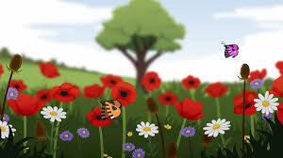
Seeds and Bulbs: Germination
BBC Bitesize - What does a plant need to grow?
Click the link below to find out more about germination.
https://www.bbc.co.uk/bitesize/to
pics/zpxnyrd/articles/zxxsyrd

Slide 7
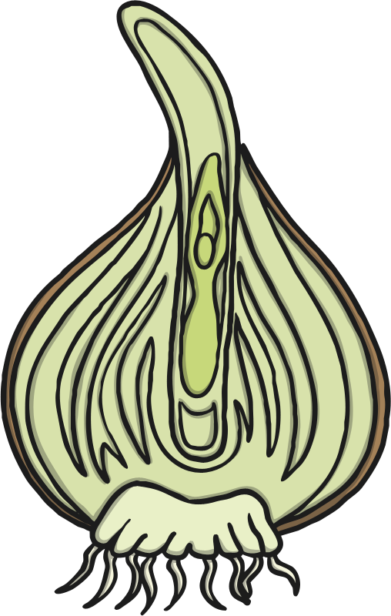
Seeds and Bulbs
Some plants grow first from a seed, and then develop a bulb that helps them to grow back year after year.
A bulb lets the plant rest underground over the winter when it is too cold, then grow back later in the year when conditions are right.
Flower Bud:
Future flower stored inside the bulb for protection.
Tunic:
A papery outer covering.
Scales:
Thick leaves that store the food.
Roots
Stem

Slide 8
Seeds and Bulbs
Here are some common plants that grow from bulbs.
Lilies
Daffodils
Allium
Snowdrops
Tulips

Slide 9
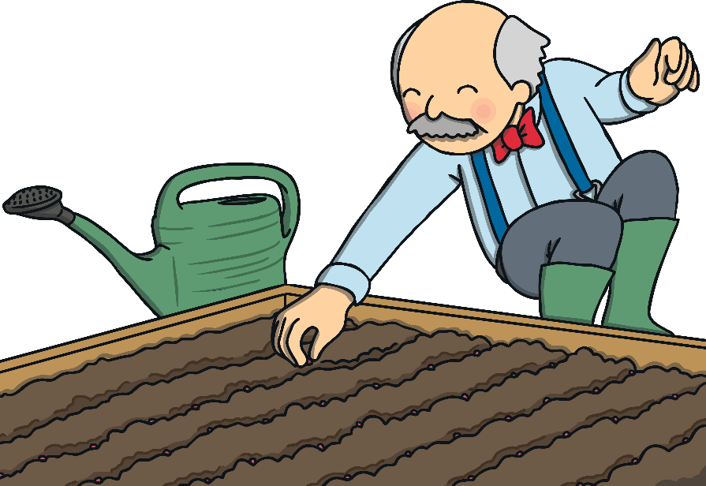
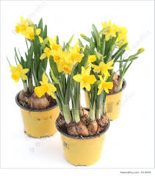
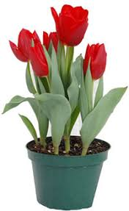
Seeds and Bulbs
In the autumn we planted daffodil and tulip bulbs. We watched them as they grew and flowered.
Later in the week, we are going to plant some seeds. But before we do that, look at the next few slides and guess if the food is a seed or a bulb?

Slide 10
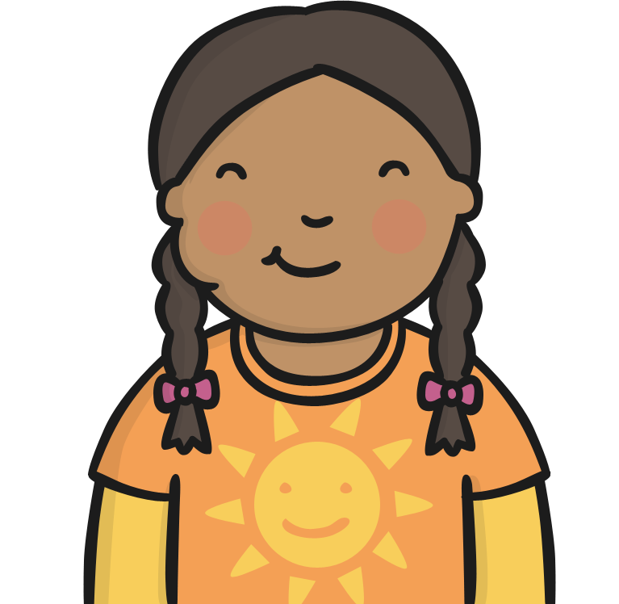
Seed or Bulb Quiz

Slide 11
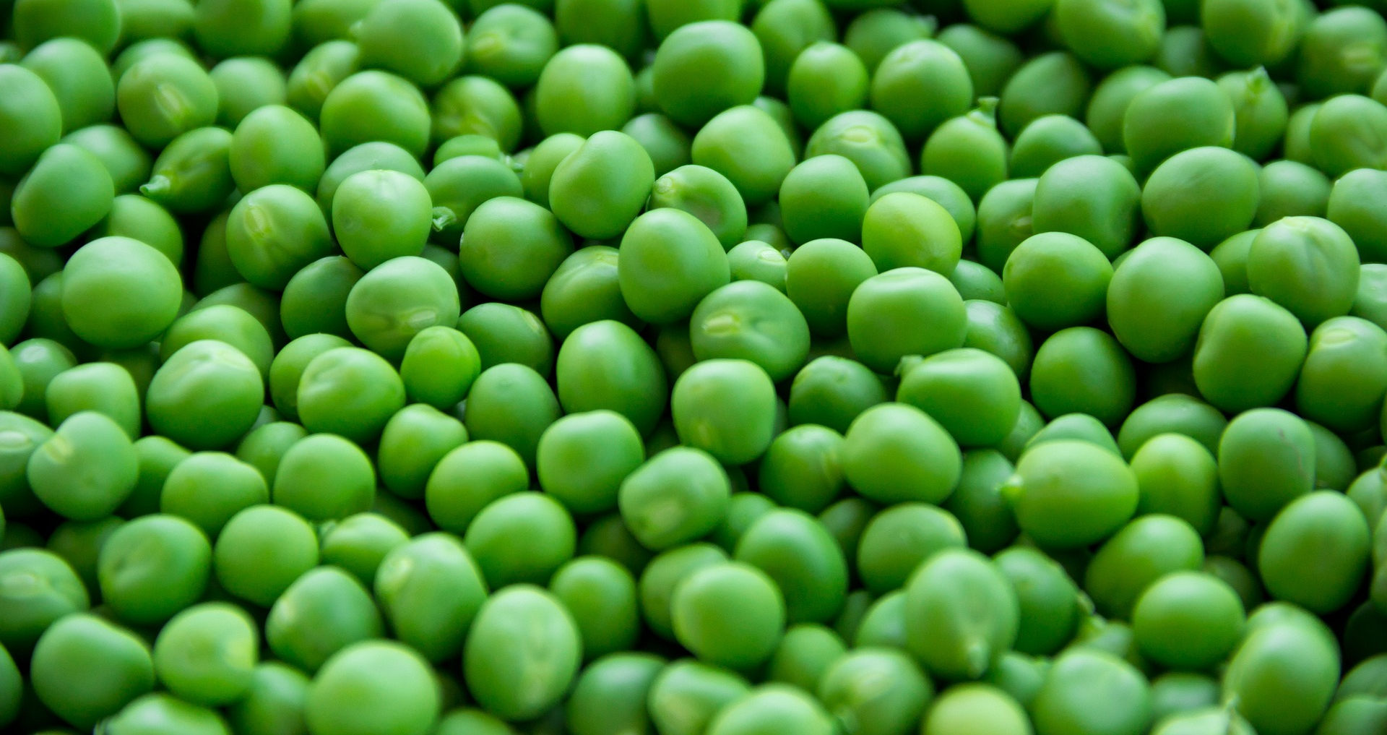
Peas
Seed
Bulb

Slide 12
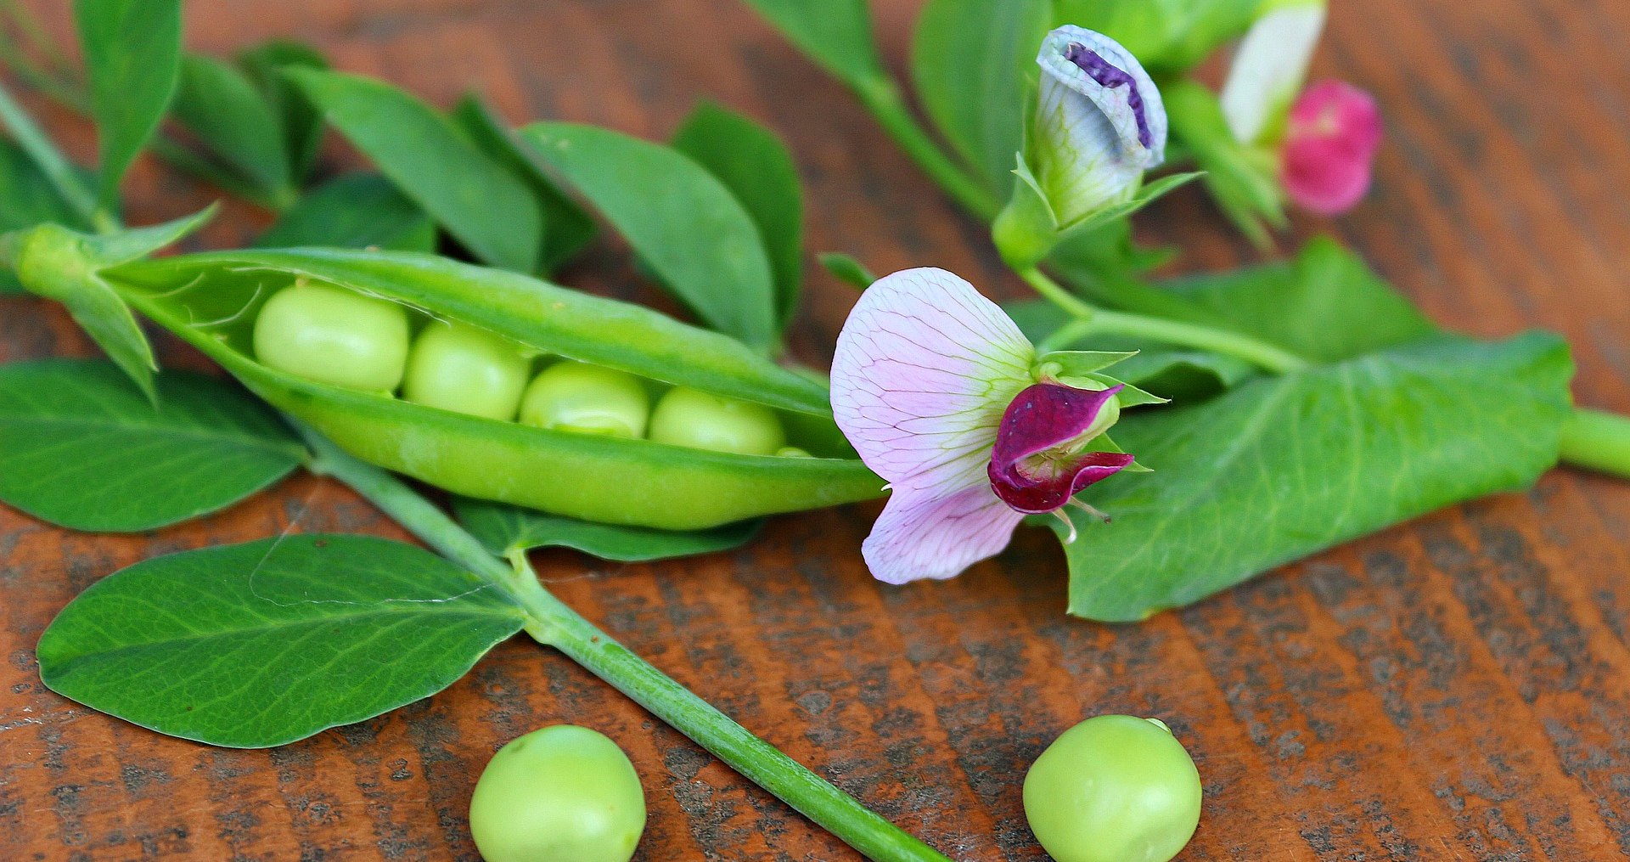
Peas
Correct!
A pea is a seed. Well done!

Slide 13
Peas
Bad luck!
A pea is actually a seed.

Slide 14
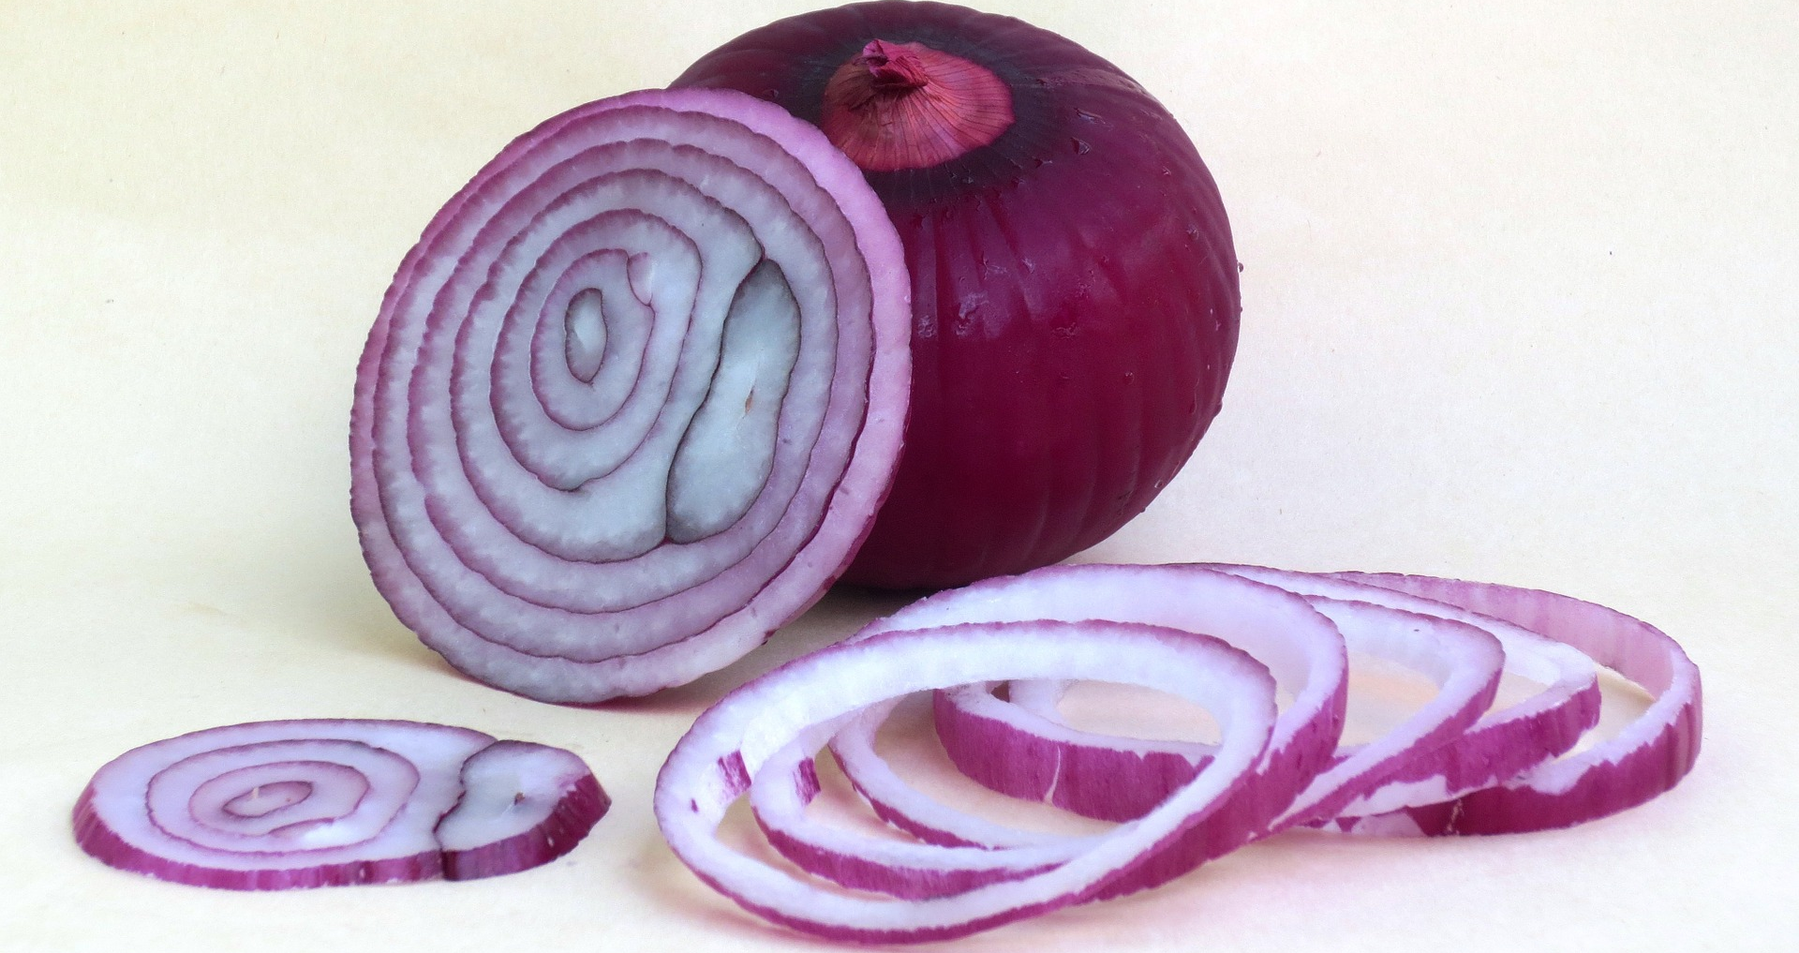
Onion
Seed
Bulb

Slide 15
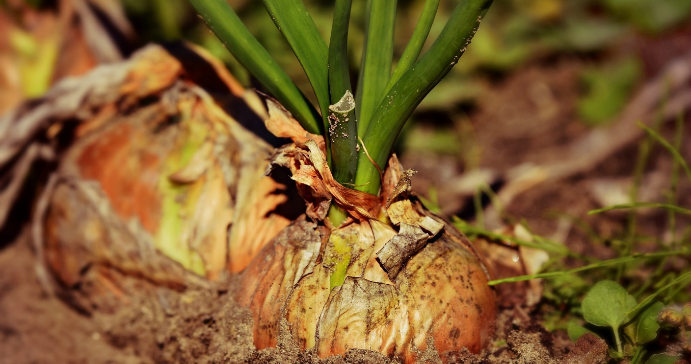
Onion
Correct!
An onion is a bulb. Well done!

Slide 16
Onion
Bad luck!
An onion is actually a bulb.

Slide 17
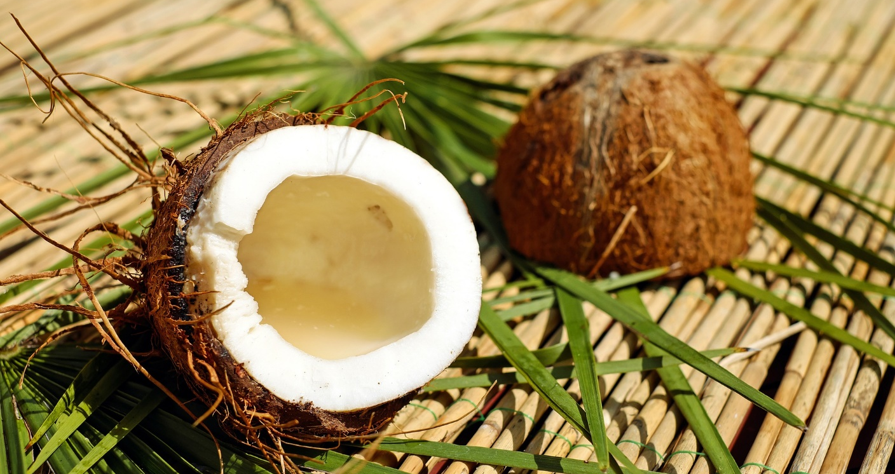
Coconut
Seed
Bulb

Slide 18
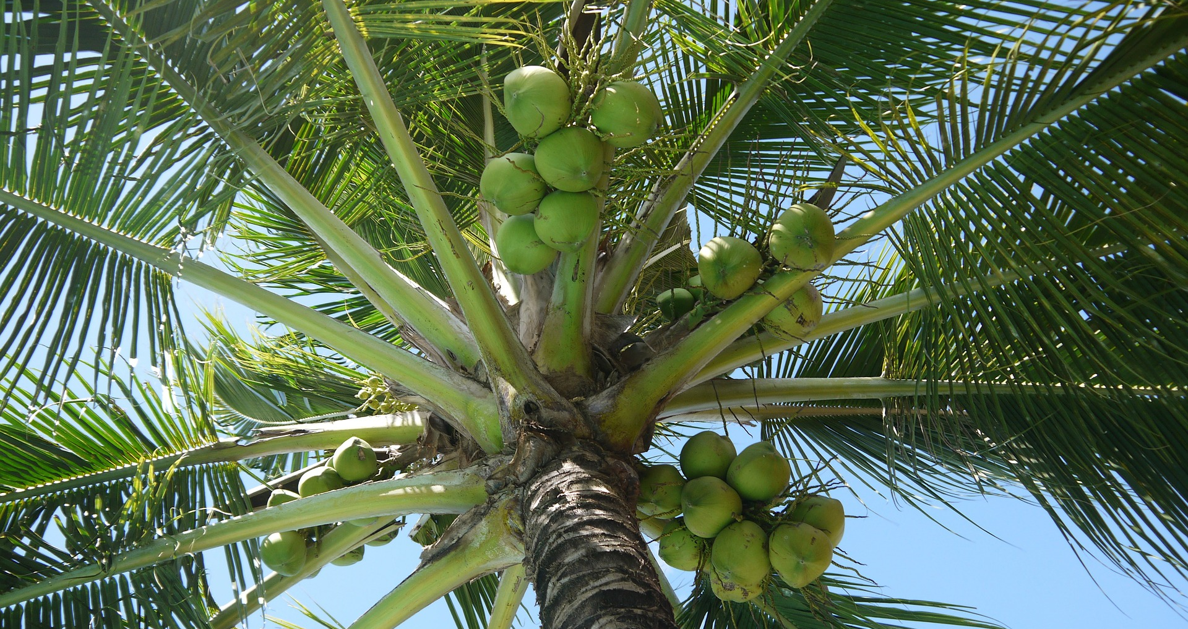
Coconut
Correct!
A coconut is a seed. Well done!

Slide 19
Coconut
Bad luck!
A coconut is actually a seed.

Slide 20
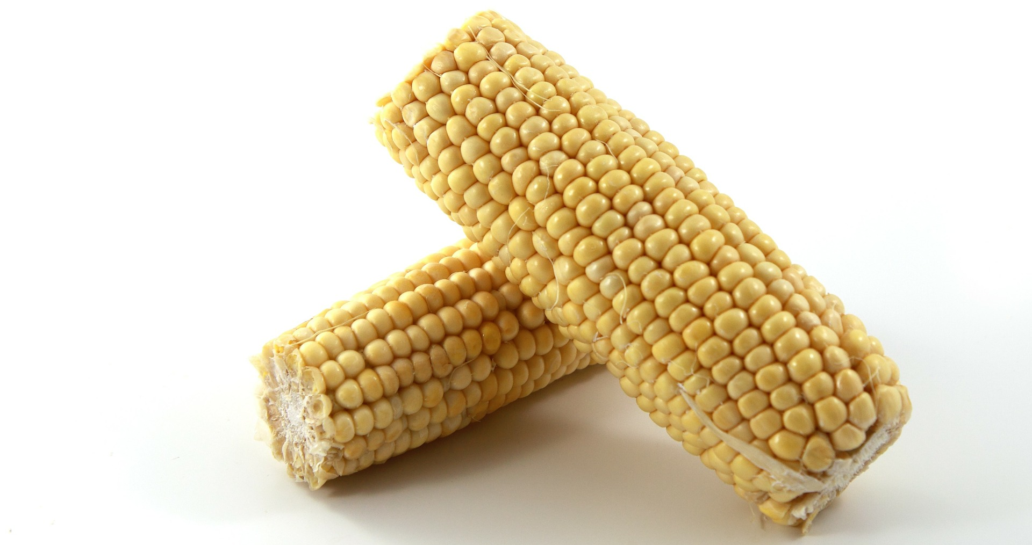
Sweetcorn
Seed
Bulb

Slide 21
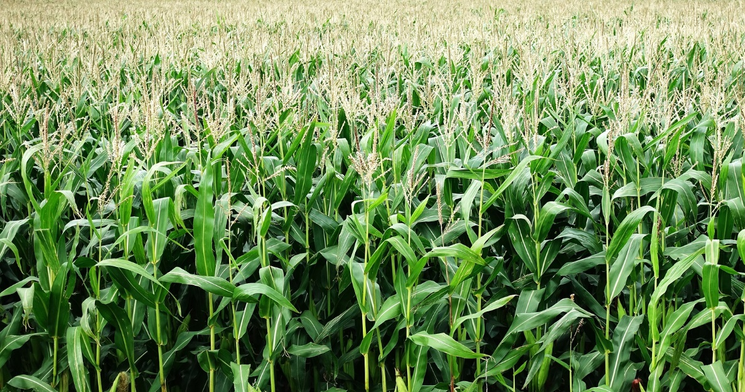
Sweetcorn
Correct!
A corn kernel is a seed. Well done!

Slide 22
Sweetcorn
Bad luck!
A corn kernel is actually a seed.

Slide 23
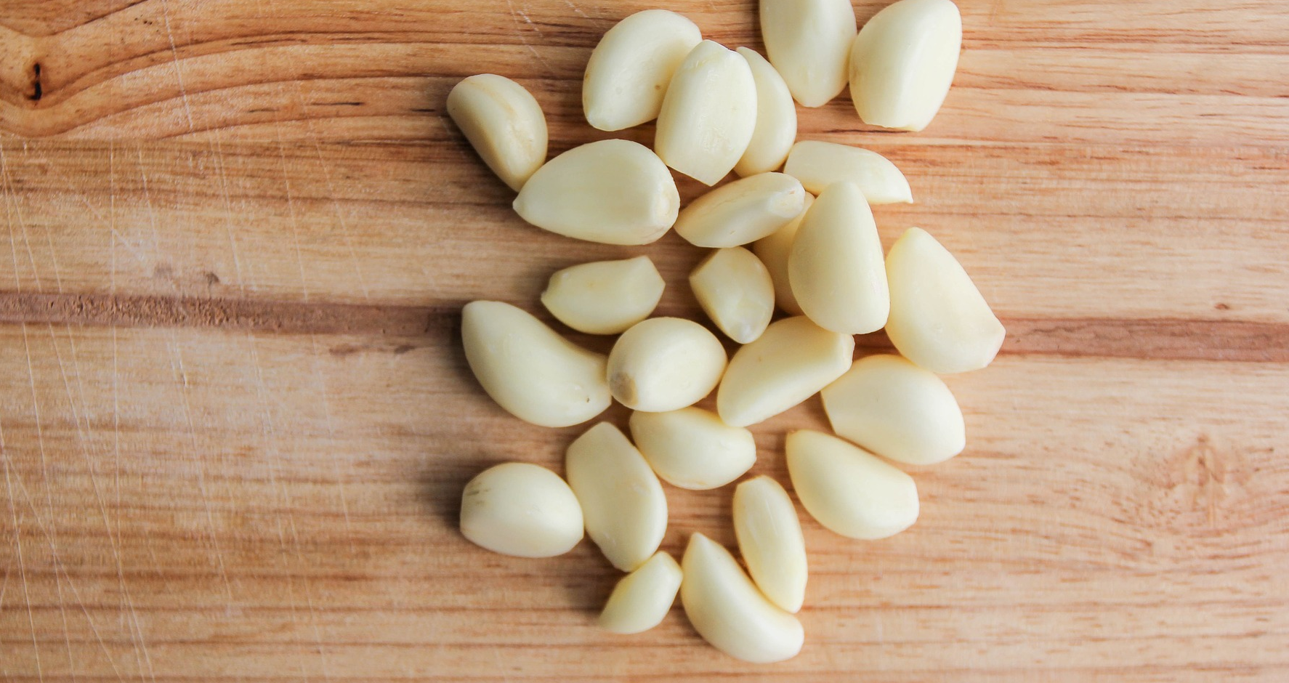
Garlic
Seed
Bulb

Slide 24
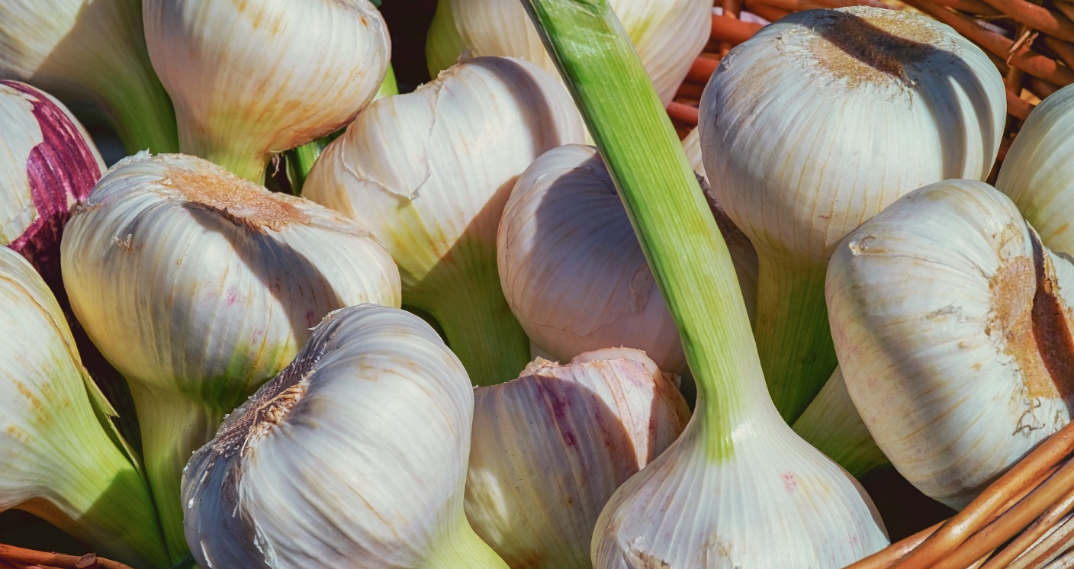
Garlic
Correct!
Garlic is a bulb. Well done!

Slide 25
Garlic
Bad luck!
Garlic is actually a bulb.

Slide 26
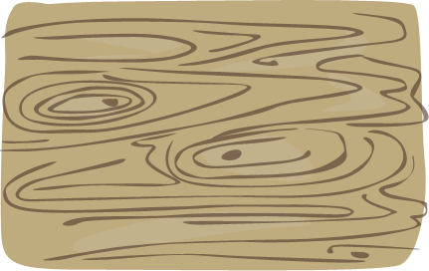
Your Go!
Write 5 sentences about seeds and bulbs. Use the coordinating conjunctions ‘and’ & ‘but’ at least once in your sentences.
Can you use the word ‘because’ in one of your sentences?

