Slide 1
Exciting Write Week 4
A few things to remember:
A range of punctuation.
A new paragraph for a new time, place or character in the story.
Sentences should have conjunctions, adjectives and well chosen verbs to add detail.
Speech marks around the words when someone speaks.
Try and do your write for about half an hour.

Slide 2
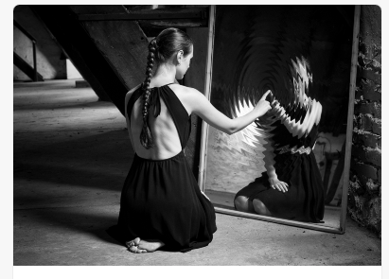
She had found it lying alone, deserted, abandoned in the attic. After making the discovery, Anna had gazed and marvelled at it for some time. Where had it come from? Why had no dust settled upon it, as it had done over everything else that resided in her attic? A layer of the thick dust blanketed the attic floor, and as the sunlight glared through the attic windows, the dust particles yet to settle were illuminated as they hovered in the stuffy air. Yet, the mirror looked flawless, untouched by age, not a finger print in sight.
Anna propped the mirror up against one of the thick, timber beams that jutted from the attic floor. Settling down into a comfortable position, she tentatively placed a finger against the glass…
Continue the story.

