Slide 1
Information and images taken from Twinkl Website.

Slide 7
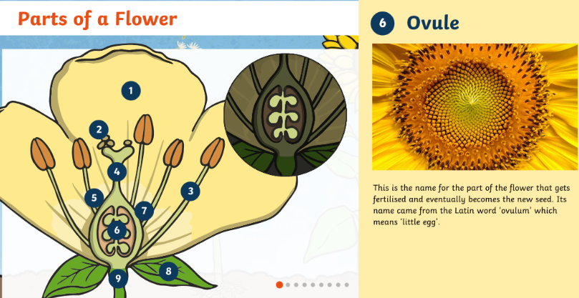

Slide 9
