Slide 1
Slow write
Take it one sentence at a time. Make sure your sentences include the things that I have put on the list.

Slide 2
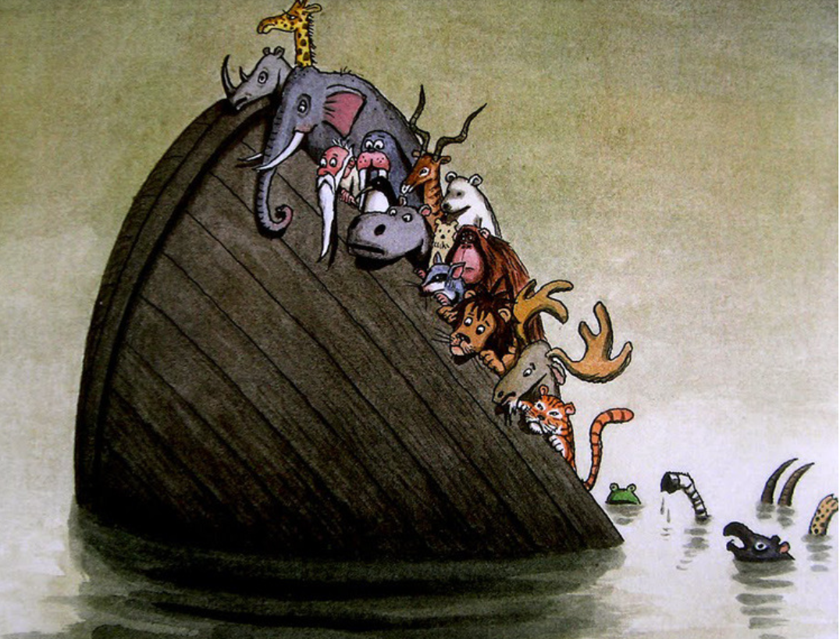
This is what your Slow Write will be about. The next slide will show you what it needs to include.

Slide 3
Sentence 1- Must be written in the past continuous tense.
Sentence 2- Must contain a subordinating conjunction.
Sentence 3- Must include a fronted adverbial (of place).
Sentence 4- Must include an adverb.
Sentence 5- Must include a coordinating conjunction.
Sentence 6- Must include a plural possessive apostrophe.
Sentence 7- Must be a rhetorical question.

Slide 4
The boat was sinking quickly.
The animals on board fell silent as the boat tipped up further.
In the water, the zebra struggled to stay afloat.
The tiger gripped on tightly to the edge of the boat and closed his eyes.
All the animals were frightened and they were regretting their decision to escape from the zoo.
The zoo keepers’ remarks had been unkind but they had never actually harmed any of the animals.
Had it really been that bad back there?

Slide 5
Remember that your writing needs to be written as a paragraph, not just individual sentences. Check that it is cohesive, that it flows well and doesn’t ‘jump around’ at all.
The boat was sinking quickly. The animals on board fell silent as the boat tipped up further. In the water, the zebra struggled to stay afloat. The tiger gripped on tightly to the edge of the boat and closed his eyes. All the animals were frightened and they were regretting their decision to escape from the zoo. The zoo keepers’ remarks had been unkind but they had never actually harmed any of the animals. Had it really been that bad back there?

