Slide 1
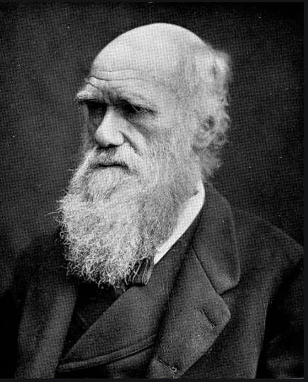
Charles Darwin-The Science of Evolution
By James Waring

Slide 2
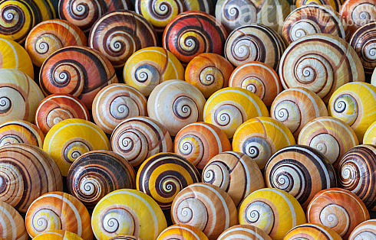
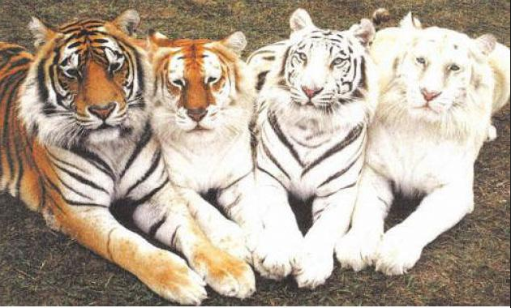
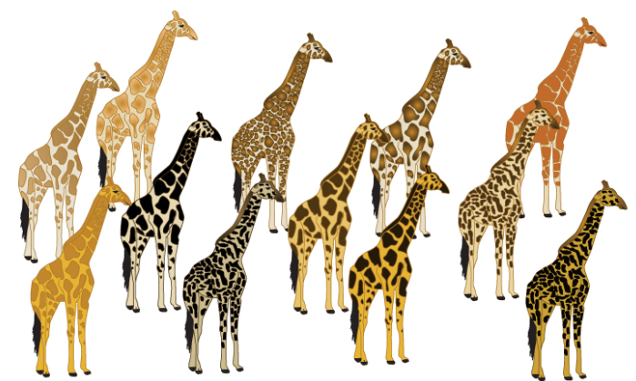
Charles Darwin was born on the 12th February 1809. He was a naturalist who studied variation in plants, animals and fossils. Variation means: the difference between individuals within a population.
Naturalist

Slide 3
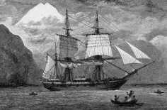
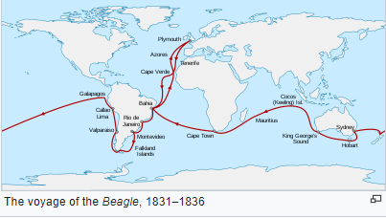
In 1831, he went on a ship called the HMS Beagle and explored the Galapágos Islands. During his five week visit, Darwin found lots of creatures such as giant tortoises, mocking birds, finches and other unusual animals. He was interested in the differences he saw between species on the different islands. When he got back to England, he began to develop his theory of ‘natural selection’.
HMS Beagle

Slide 4
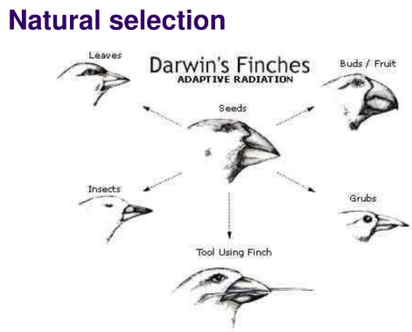
Natural selection is: ‘a natural process that results in the survival and reproductive success of individuals or groups best adjusted to their environment and that leads to the perpetuation of genetic qualities best suited to that particular environment.’
Natural Selection

Slide 5
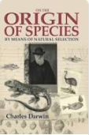
On November 24th 1859, he published a detailed explanation of his theory in his book called ’On the Origin of Species by Means of Natural Selection’ (28 years after his voyage). His theory challenged the idea that God made all the animals and plants, which contradicted the commonly held Christian views of his era. Only by the 1870s, did people begin to accept that his theory was true.
Book-Origin Of Species

Slide 6
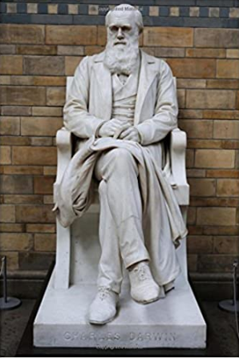
By the time of his death on the 19th April 1882, Darwin and his colleagues had convinced most scientists that evolution was correct, and he was regarded as a great scientist. He had expected to be buried in St Mary's churchyard at Downe, but after public and parliamentary petitioning, he was honoured by burial in Westminster Abbey, close to John Herschel and Isaac Newton.
Burial

Slide 7
I Hope You Found This Interesting! The End

